Slide 1
Electric Smart Fence
Assignment solution

Slide 2
Components
Arduino MEGA2560
ESP32-CAM module
MPU6050 module
PIR sensor module
LDR
Laser diode
NEO-M8N GPS module
KY-019 5v Relay module
1x
1x
4x
4x
1x
1x
1x
1x

Slide 3

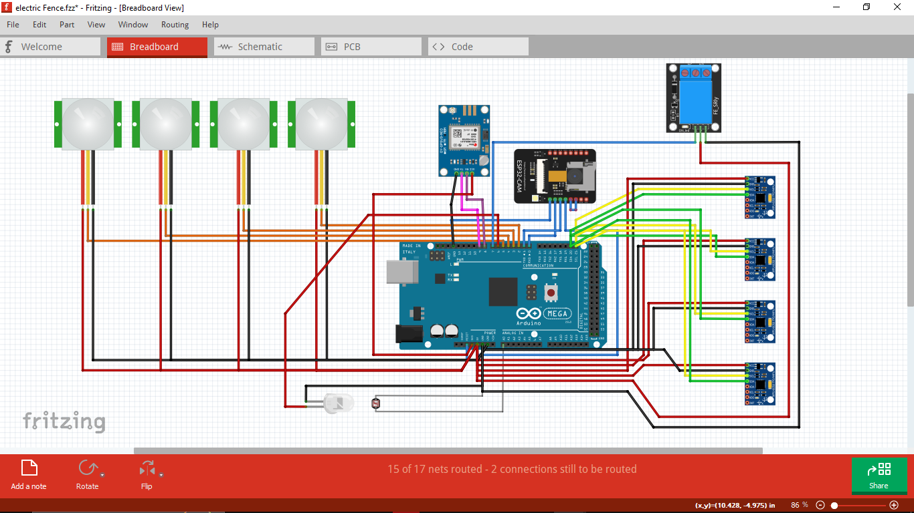
Circuit Diagram

Slide 4
Algorithm
The main microcontroller is the ATmega2560 based Arduino Mega. Connected to it is an ESP32 CAM module which will act as the IR camera.
Each vertex of the fencing will have one MPU6050 module to detect the motion of that edge and a PIR sensor to sense anyone which is in proximity of the fence vertex.
Below the fence one vertex will have a laser module pointing the laser in the direction of the next vertex, reflected by mirrors.
the laser will complete its path and return back to the main vertex where it’ll hit the LDR.
If the path of laser is broken or the fence of any edge experiences heavy motion or if the PIR sensor of a vertex detect proximity of someone, the arduino will enter the alert mode.
In the camera of ESP32 module will activate and click pictures of the fencing, showing the perpetrator and the alarms will be sounded.
An Alert mail will be sent to the owner by the Arduino MEGA. It will have the alert message as well as the Google drive link that will contain the images captured by the ESP32 CAM module.

Slide 5
In the Alert mode, The camera of ESP32 module will activate and click pictures of the fencing, showing the perpetrator
The Alarms will also be sounded and the relay will turn ON supplying 220V AC to the fencing.
An Alert mail will be sent to the owner by the Arduino MEGA.
It will have the alert message which will contain the GPS location of the fence side that was disturbed, given by the NEO-M8N GPS module
The Mail will also include a Google drive link that will contain the images captured by the ESP32 CAM module.

Slide 6
Thank You
- By, Devvrat Bani

